Slide 1


Slide 2
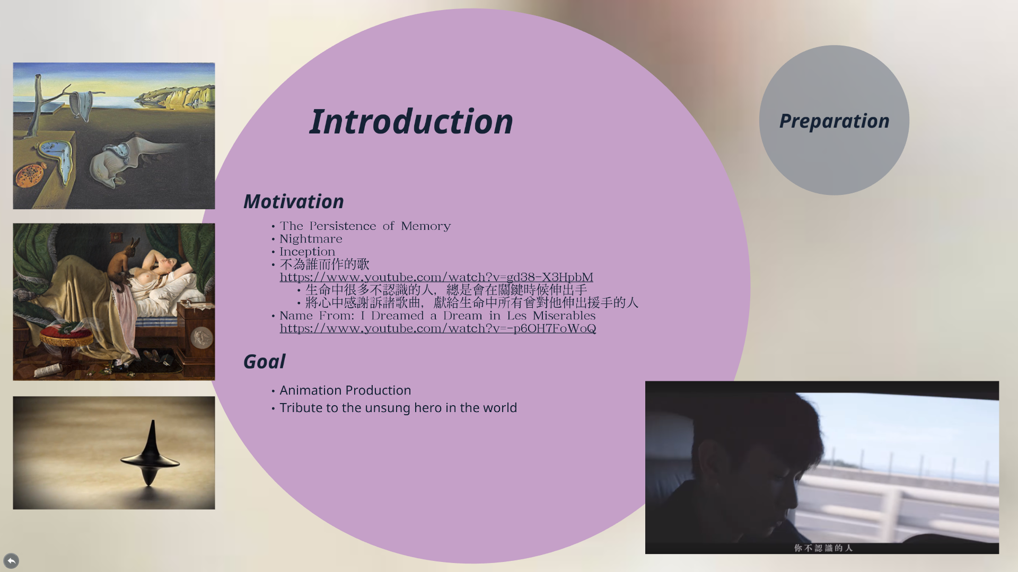

Slide 3
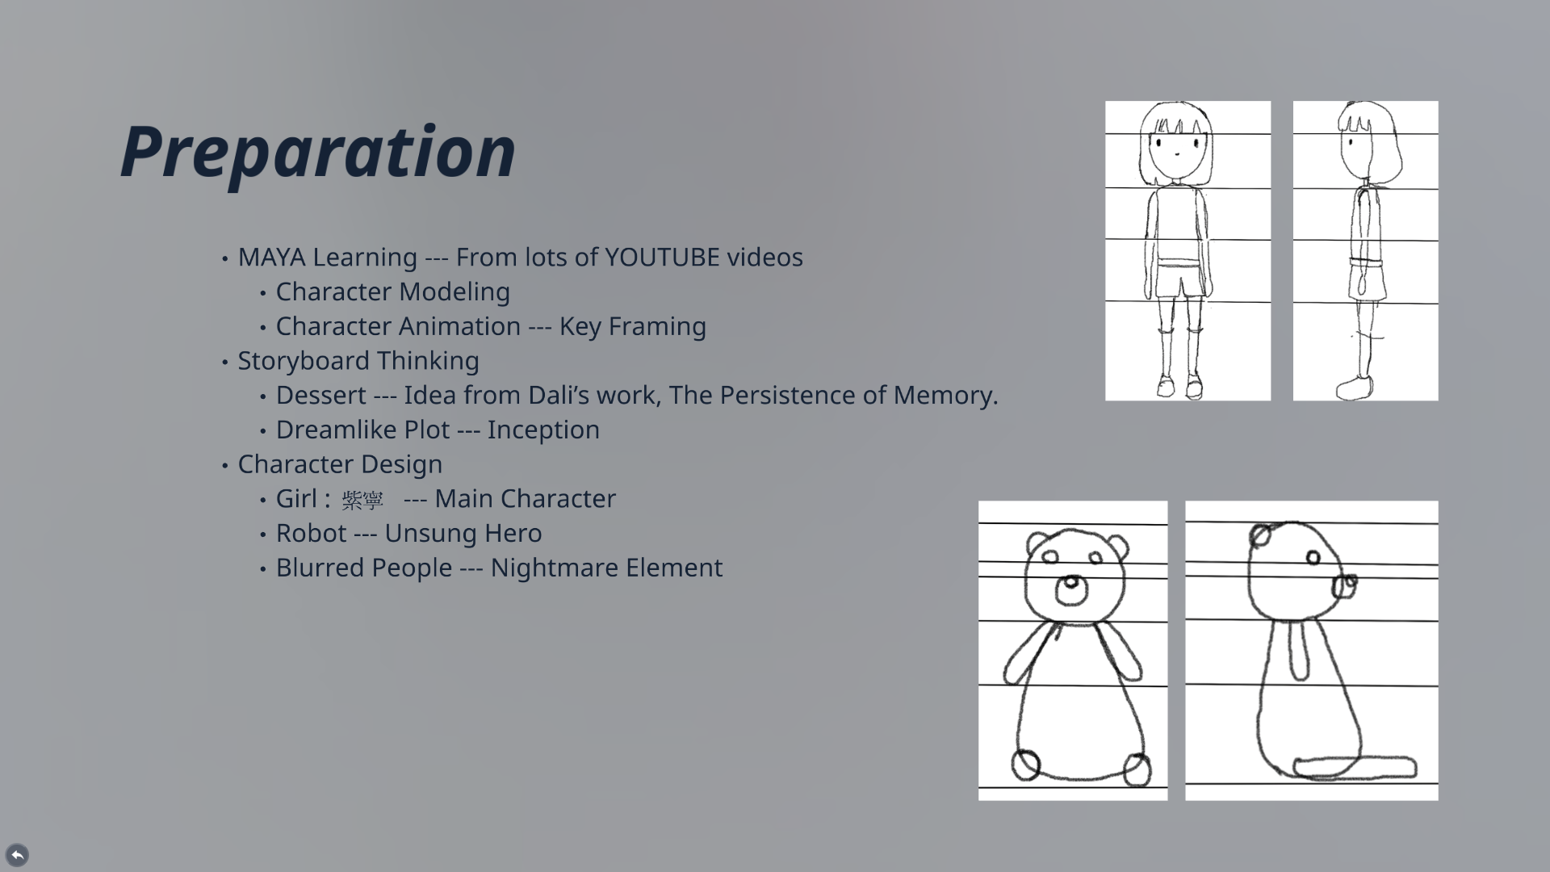

Slide 4
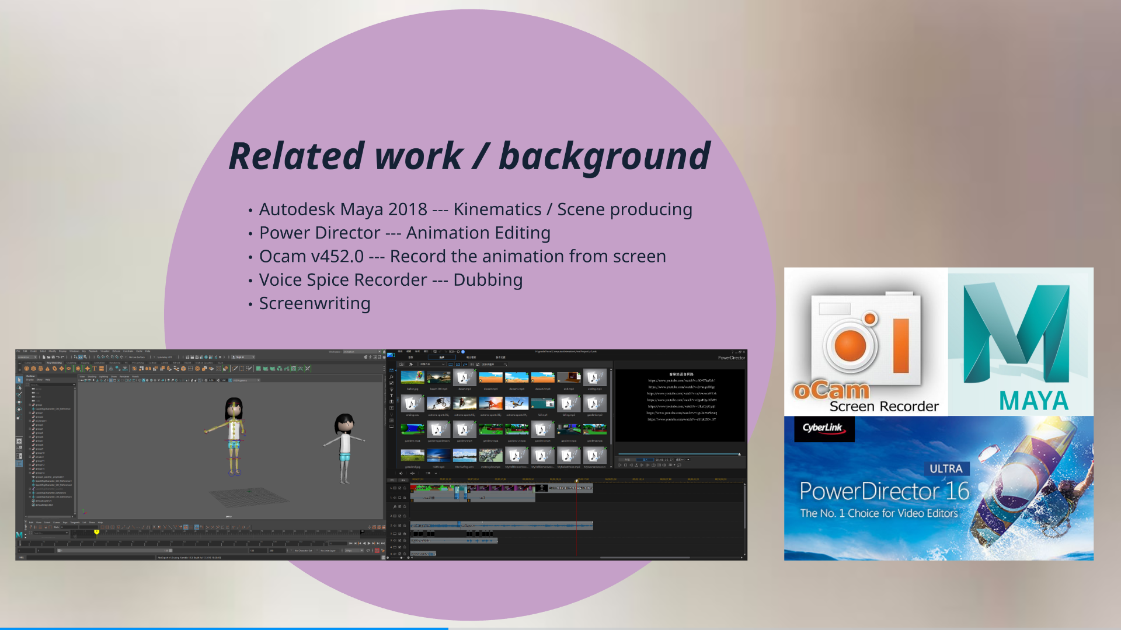

Slide 5
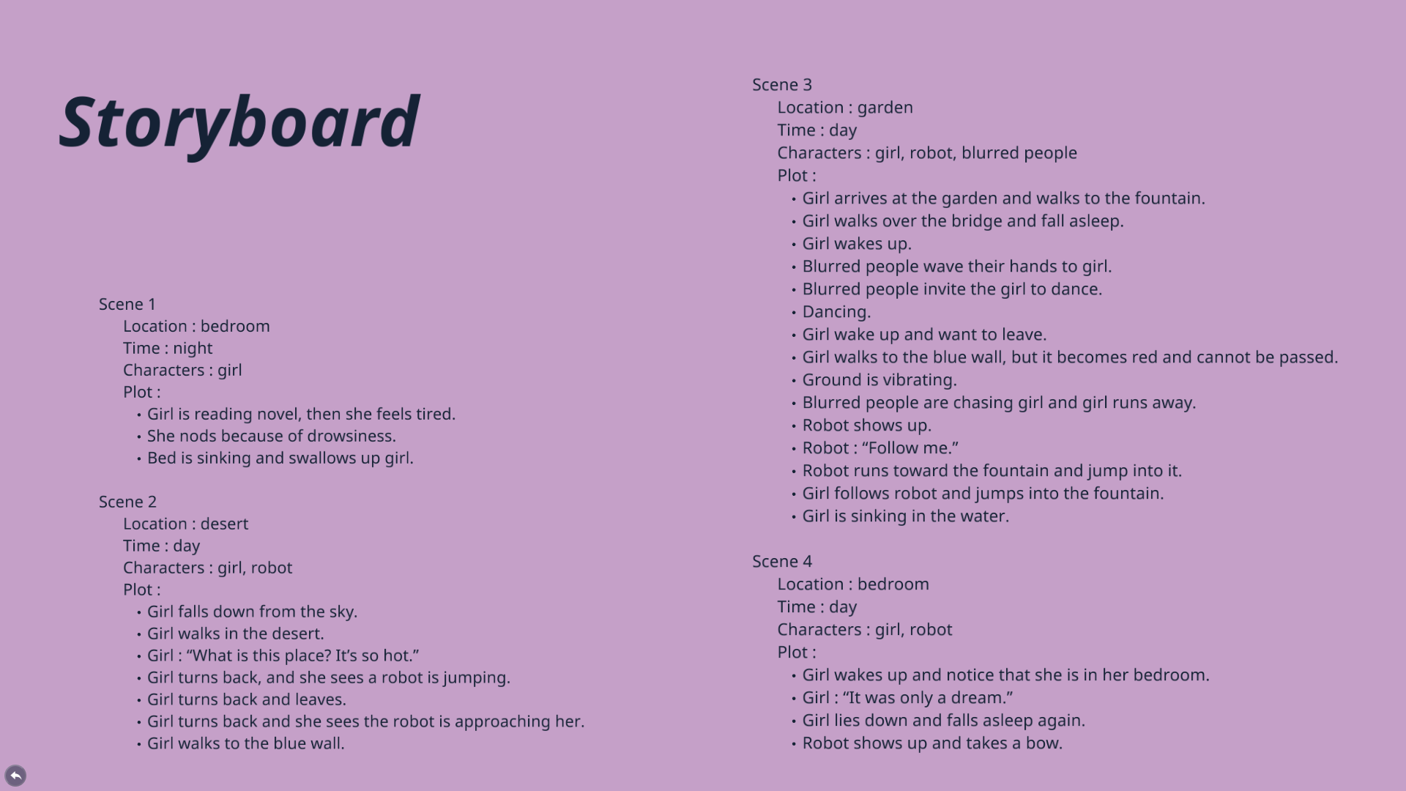

Slide 6
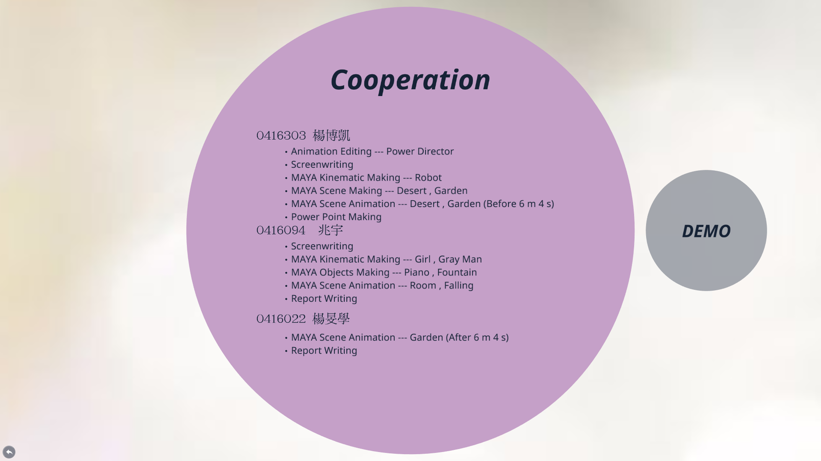

Slide 7
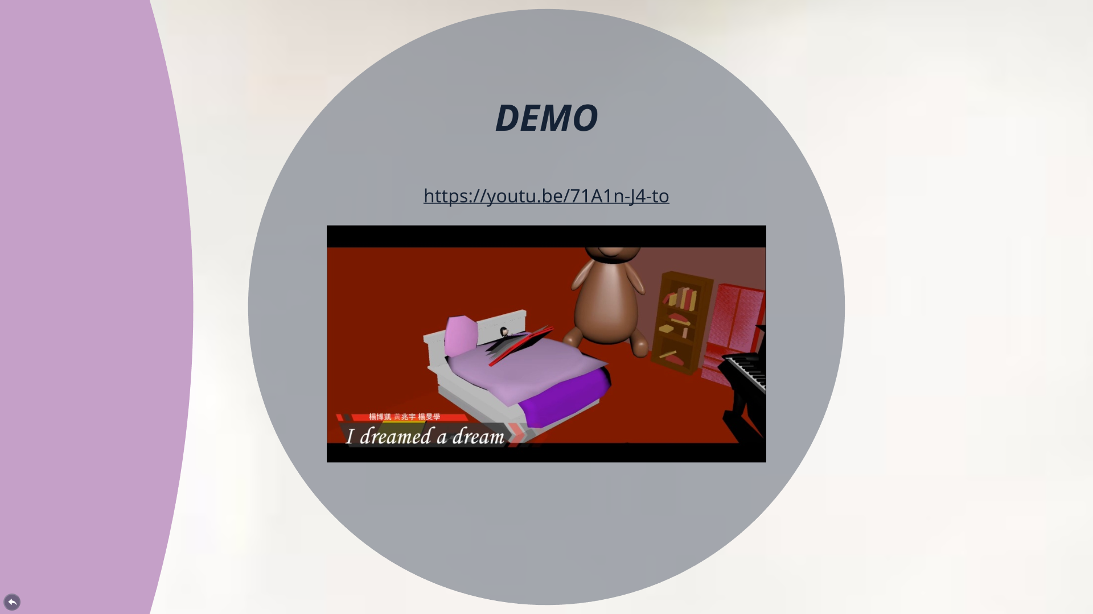

Slide 8
PRESENT PPT:
https://prezi.com/view/TIsXQ8szCgwIqPvsI7jO/

